Slide 1

Braj-Darshan Project
Simplifying spiritual and cultural tourism in the land of Lord Krishna.
- by Sameer Khan

Slide 2
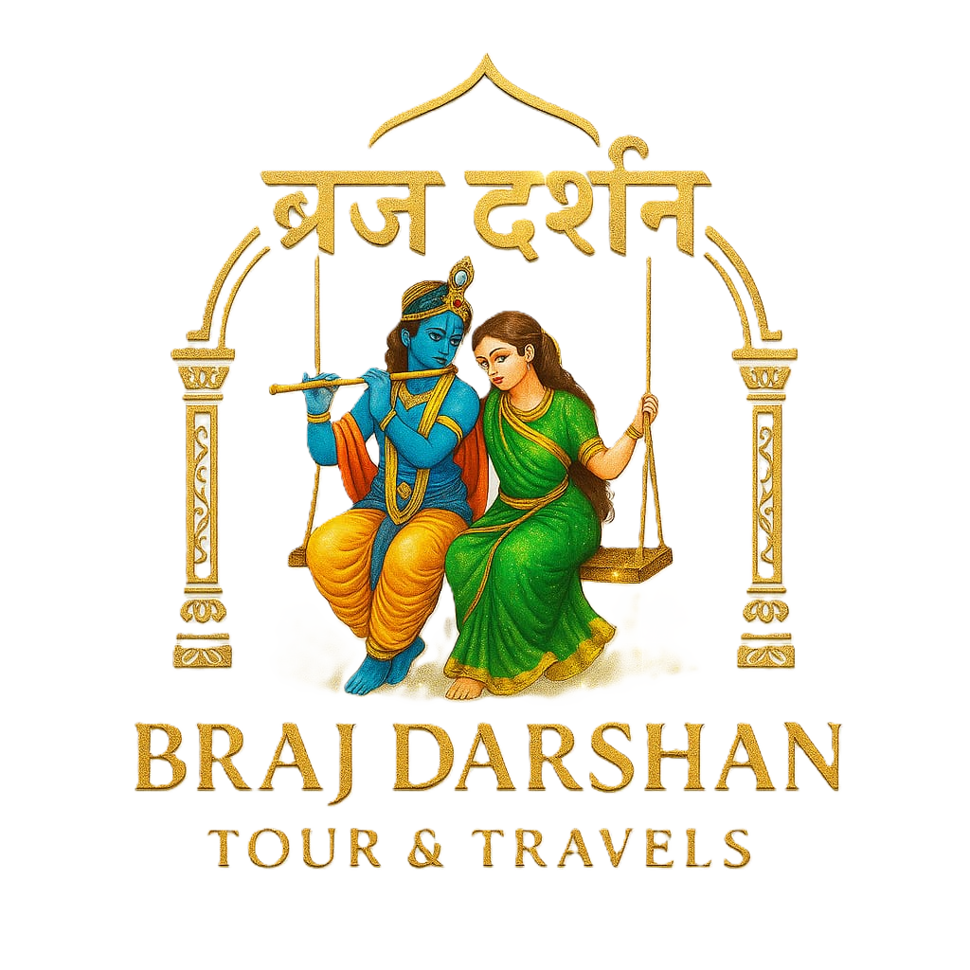
Braj - Darshan Tour & Travels
This project is a web-based application designed to promote tourism in the Braj region. It offers users an elegant, user-friendly platform to explore attractions, hotels, and services, and to book tours online. The goal is to connect tourists with local experiences digitally, enhancing trip planning and travel convenience.
The Braj region is culturally and spiritually significant, attracting many pilgrims and tourists annually. This project addresses travel planning challenges by providing a centralized, interactive platform for bookings and information.

Slide 3

Technology Stack and Features
Frontend Technologies
Backend and Database
Key Features
Includes online tour booking, real-time messaging, mobile-friendly design, light/dark mode, and multiple content sections.
HTML, CSS, JavaScript, GSAP, and Locomotive Scroll create smooth animations and responsive UI.
Node.js and Express.js power the backend API, with MongoDB managing data storage.

Slide 4
System Architecture and Pages Overview
Frontend
Backend API
Built with HTML, CSS, and JavaScript, featuring smooth scroll and animated hero sections.
Express.js handles form submissions and data management.
Pages include Booking Form, Message Box, Attractions, Hotels, About Us, Services, and Reviews.
Includes navigation bar with smooth transitions and scroll-based color changes.

Slide 5

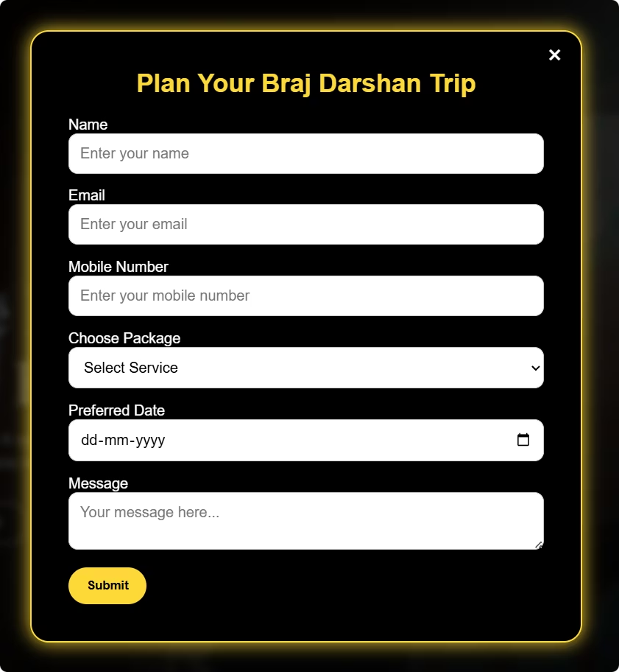
Interactive Pages and User Experience
Booking Form
Message Box
Users select destination, date, and vehicle type with backend API handling submissions and confirmations.
Simple contact form sends messages stored in MongoDB for efficient communication.
Attractions and Hotels
Auto-scrolling image sliders and hotel cards with alternating layouts enhance visual appeal.

Slide 6
About Us, Services, and Reviews
About Us
Services
Reviews
Features founder Bablu Khan’s bio and customer testimonials with ratings.
Cards highlight tour guides, cab rentals, accommodation, with hover and animation effects.
Customer reviews listed with an option to add new reviews via modal popup.

Slide 7

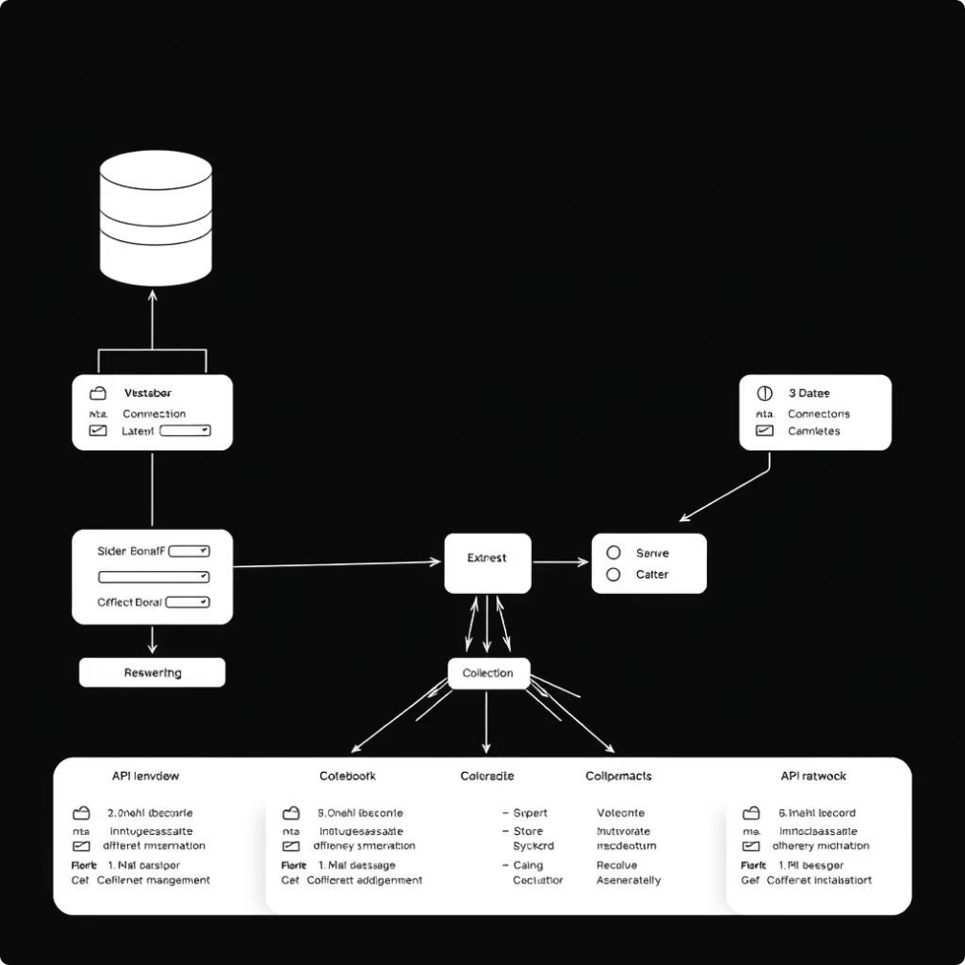



Backend APIs and Database Collections
Booking API
Handles tour bookings with data saved in MongoDB bookings collection.
Message API
Stores user messages securely in the messages collection.
Reviews API
Fetches and adds customer reviews stored in the reviews collection.

Slide 8

Implementation Challenges and Solutions
Performance Optimization
Mobile Responsiveness
Backend Stability
Managed connectivity and error handling effectively for reliable API performance.
Integrated GSAP and Locomotive Scroll without causing lags for smooth animations.
Used custom media queries to ensure full functionality on all devices.

Slide 9

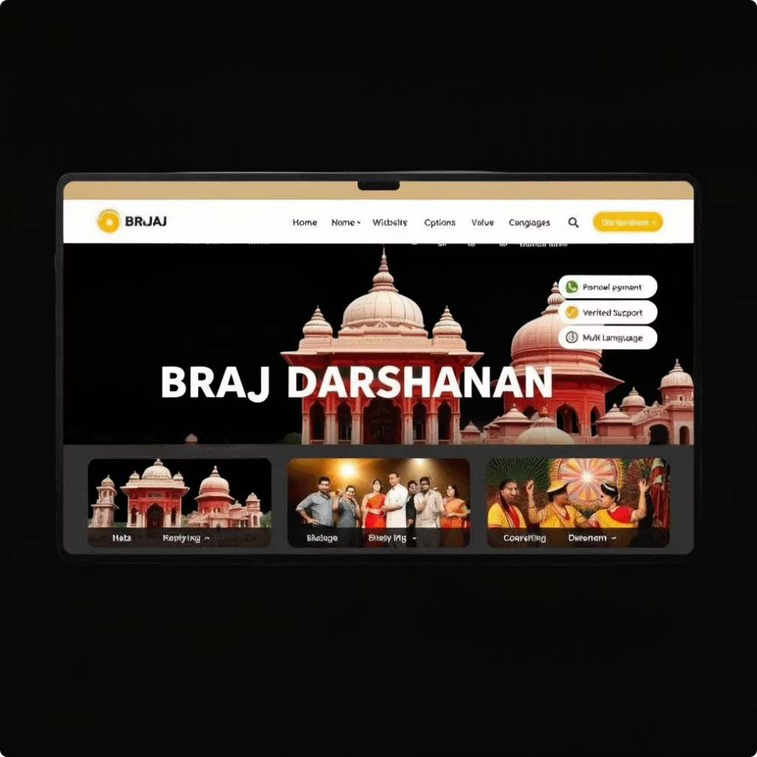
Conclusion and Future Scope
This website bridges traditional Braj culture with modern tourism needs, helping tourists plan and find verified services easily. It enhances the travel experience by providing a centralized digital platform.
Future enhancements include adding online payment options and multi-language support to expand accessibility and convenience for a wider audience.

Slide 10
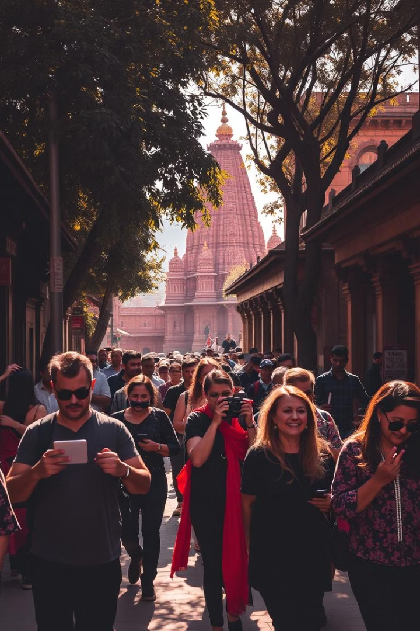
From Braj to Beyond – The Journey Continues!
Digitally transforming Braj’s tourism landscape for seamless exploration and authentic experiences

Slide 11

Bridging Tradition with Innovation Thank You!

